Slide 1
CHAPTER 11
FUZZY ARITHMETIC AND FUZZY MEASURES
“Principles of Soft Computing, 2nd Edition”
by S.N. Sivanandam & SN Deepa
Copyright © 2011 Wiley India Pvt. Ltd. All rights reserved.

Slide 2
FUZZY ARITHMETIC
Distributions do not have to be precise.
Requires no assumption about correlations.
Fuzzy measures are upper bounds on probability.
Fuzzy arithmetic might be a conservative way to do risk assessments.
“Principles of Soft Computing, 2nd Edition”
by S.N. Sivanandam & SN Deepa
Copyright © 2011 Wiley India Pvt. Ltd. All rights reserved.

Slide 3
FUZZY NUMBERS AND THEIR ARITHMETIC
Fuzzy numbers
  Fuzzy sets of the real line,
  Unimodal,
  Reach possibility level one.
Fuzzy arithmetic
  Interval arithmetic at each possibility level.
“Principles of Soft Computing, 2nd Edition”
by S.N. Sivanandam & SN Deepa
Copyright © 2011 Wiley India Pvt. Ltd. All rights reserved.

Slide 4
FEATURES OF FUZZY ARITHMETIC
Fully developed arithmetic and logic
  Addition, subtraction, multiplication, division, min, max;
  Log, exp, sqrt, abs, powers, and, or, not;
  Backcalculation, updating, mixtures, etc.
Very fast calculation and convenient software.
Very easy to explain.
Distributional answers (not just worst case).
Results robust to choice about shape.
“Principles of Soft Computing, 2nd Edition”
by S.N. Sivanandam & SN Deepa
Copyright © 2011 Wiley India Pvt. Ltd. All rights reserved.

Slide 5
TYPES OF NUMBERS
Scalars are well-known or mathematically defined integers and real numbers.
Intervals are numbers whose values are not know with certainty but about which bounds can be established.
Fuzzy numbers are uncertain numbers for which, in addition to knowing a range of possible values, one can say that some values are more plausible than others.
“Principles of Soft Computing, 2nd Edition”
by S.N. Sivanandam & SN Deepa
Copyright © 2011 Wiley India Pvt. Ltd. All rights reserved.

Slide 6
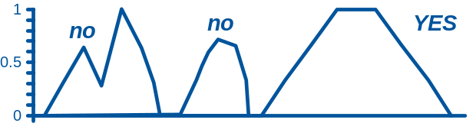
FUZZY NUMBERS
Fuzzy set that is unimodal and reaches 1.
Nested stack of intervals.
“Principles of Soft Computing, 2nd Edition”
by S.N. Sivanandam & SN Deepa
Copyright © 2011 Wiley India Pvt. Ltd. All rights reserved.

Slide 7
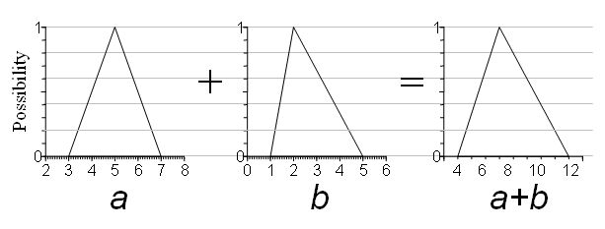
LEVEL-WISE INTERVAL ARITHMETIC
“Principles of Soft Computing, 2nd Edition”
by S.N. Sivanandam & SN Deepa
Copyright © 2011 Wiley India Pvt. Ltd. All rights reserved.

Slide 8
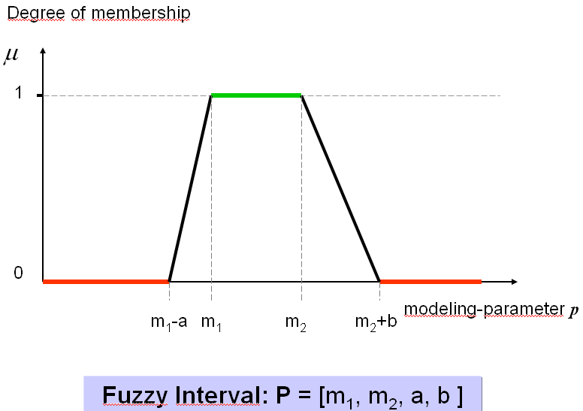
FUZZY INTERVALS BY TRAPEZOIDAL SHAPES
“Principles of Soft Computing, 2nd Edition”
by S.N. Sivanandam & SN Deepa
Copyright © 2011 Wiley India Pvt. Ltd. All rights reserved.

Slide 9
FUZZY ADDITION
1
A
B
A+B
0.5
0
0
0
2
4
6
8
Subtraction, multiplication, division, minimum, maximum, exponentiation, logarithms, etc. are also defined.
If distributions are multimodal, possibility theory (rather than just simple fuzzy arithmetic) is required.
“Principles of Soft Computing, 2nd Edition”
by S.N. Sivanandam & SN Deepa
Copyright © 2011 Wiley India Pvt. Ltd. All rights reserved.

Slide 10
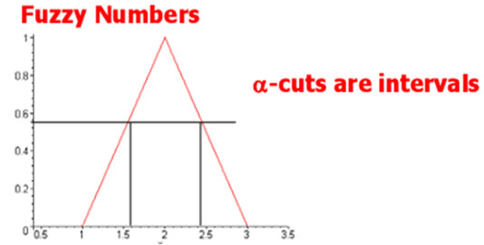
FUZZY ARITHMETIC
Interval Arithmetic
[a, b] + [d, e] = [a+d, b+e]
[a, b] - [d, e] = [a-e, b-d]
[a, b] x [d, e] = [min(a.d, a.e, b.d, b.e), max(a.d, a.e, b.d, b.e)]
[a, b]/[d, e] = [min(a/d, a/e, b/d, b/e), max(a/d, a/e, b/d, b/e)]
“Principles of Soft Computing, 2nd Edition”
by S.N. Sivanandam & SN Deepa
Copyright © 2011 Wiley India Pvt. Ltd. All rights reserved.

Slide 11
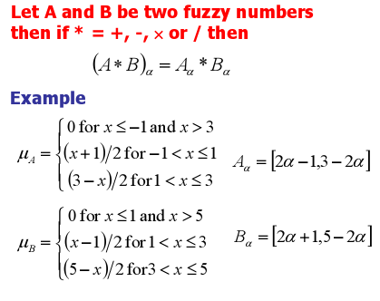
“Principles of Soft Computing, 2nd Edition”
by S.N. Sivanandam & SN Deepa
Copyright © 2011 Wiley India Pvt. Ltd. All rights reserved.

Slide 12
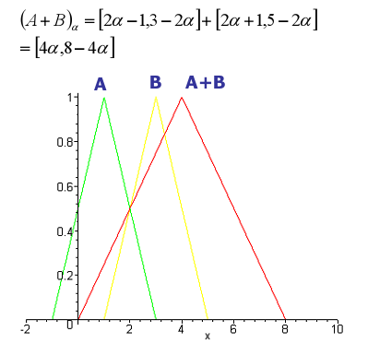
“Principles of Soft Computing, 2nd Edition”
by S.N. Sivanandam & SN Deepa
Copyright © 2011 Wiley India Pvt. Ltd. All rights reserved.

Slide 13
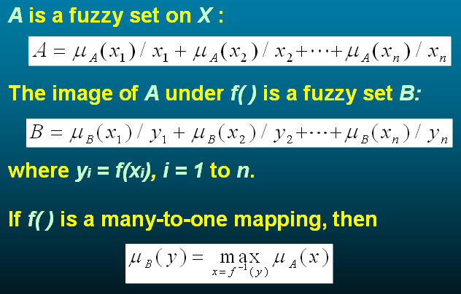
EXTENSION PRINCIPLE
“Principles of Soft Computing, 2nd Edition”
by S.N. Sivanandam & SN Deepa
Copyright © 2011 Wiley India Pvt. Ltd. All rights reserved.

Slide 14
VARIOUS FUZZY MEASURES
Belief and Plausibility Measure.
Probability Measure.
Possibility and Necessity Measure.
“Principles of Soft Computing, 2nd Edition”
by S.N. Sivanandam & SN Deepa
Copyright © 2011 Wiley India Pvt. Ltd. All rights reserved.

Slide 15
POSSIBILITY MEASURE
No single definition.
Many definitions could be used:
  Subjective assessments.
  Social consensus.
  Measurement error.
  Upper betting rates (Giles)
  Extra-observational ranges (Gaines).
“Principles of Soft Computing, 2nd Edition”
by S.N. Sivanandam & SN Deepa
Copyright © 2011 Wiley India Pvt. Ltd. All rights reserved.

Slide 16
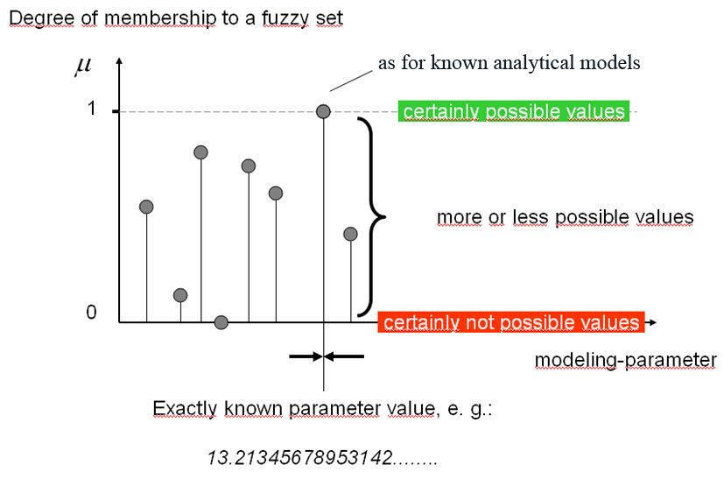
FUZZY SET AS POSSIBILITY MEASURE
“Principles of Soft Computing, 2nd Edition”
by S.N. Sivanandam & SN Deepa
Copyright © 2011 Wiley India Pvt. Ltd. All rights reserved.

Slide 17
GETTING FUZZY INPUTS
Subjective assignments:
  Make them up from highest, lowest and best-guess estimates.
Objective consensus:
  Stack up consistent interval estimates or bridge inconsistent ones.
Measurement error:
  Infer from measurement protocols.
“Principles of Soft Computing, 2nd Edition”
by S.N. Sivanandam & SN Deepa
Copyright © 2011 Wiley India Pvt. Ltd. All rights reserved.

Slide 18
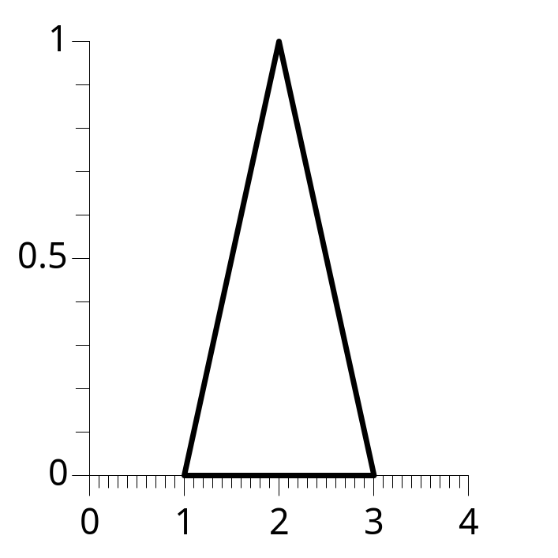
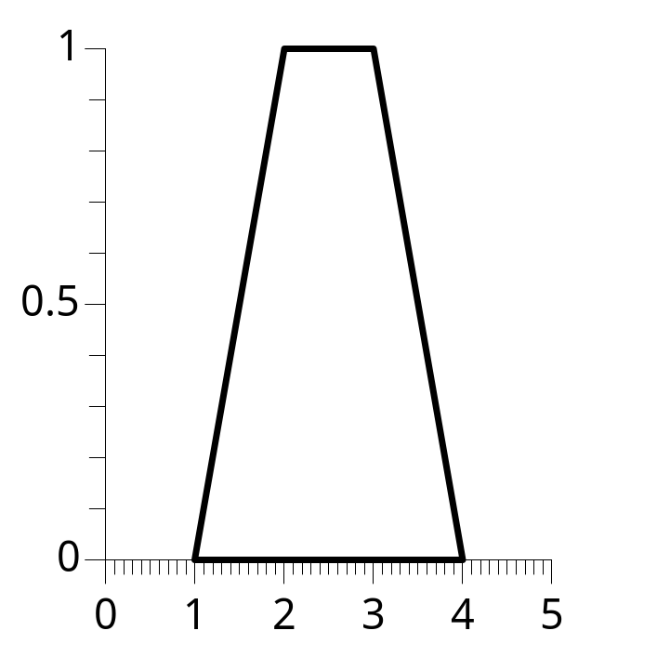
SUBJECTIVE ASSIGNMENTS
Triangular fuzzy numbers, e.g. [1,2,3].
Trapezoidal fuzzy numbers, e.g. [1,2,3,4].
Possibility
“Principles of Soft Computing, 2nd Edition”
by S.N. Sivanandam & SN Deepa
Copyright © 2011 Wiley India Pvt. Ltd. All rights reserved.

Slide 19
OBJECTIVE CONSENSUS
[1000, 3000]
[2000, 2400]
[500, 2500]
[800, 4000]
[1900, 2300]
1
0.5
Possibility
0
0
2000
4000
“Principles of Soft Computing, 2nd Edition”
by S.N. Sivanandam & SN Deepa
Copyright © 2011 Wiley India Pvt. Ltd. All rights reserved.

Slide 20
MEASUREMENT ERROR
1
46.8 ± 0.3
[46.5, 46.8, 47.1]
Possibility
0
46.5
46.7
46.9
47.1
1
[12.32]
[12.315, 12.32, 12.325]
Possibility
0
12.31
12.32
12.33
“Principles of Soft Computing, 2nd Edition”
by S.N. Sivanandam & SN Deepa
Copyright © 2011 Wiley India Pvt. Ltd. All rights reserved.

Slide 21
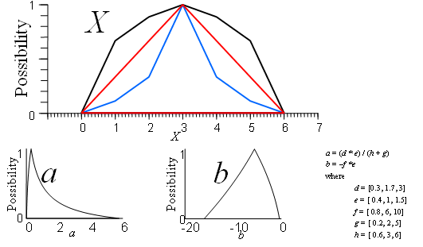
SHAPE OF X AFFECTING aX+b
“Principles of Soft Computing, 2nd Edition”
by S.N. Sivanandam & SN Deepa
Copyright © 2011 Wiley India Pvt. Ltd. All rights reserved.

Slide 22
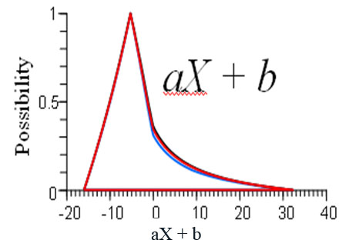
ROBUSTNESS OF THE ANSWER
Different choices for the fuzzy number X all yield very similar distributions for aX + b
“Principles of Soft Computing, 2nd Edition”
by S.N. Sivanandam & SN Deepa
Copyright © 2011 Wiley India Pvt. Ltd. All rights reserved.

Slide 23
PROBABILITY MEASURE
A fuzzy number F is said to “enclose” a probability distribution P if,
the left side of F is larger than P(x) for each x,
the right side of F is larger than 1-P(x) for each x.
For every event X < x and x < X, possibility is larger than the probability, so it is an upper bound.
“Principles of Soft Computing, 2nd Edition”
by S.N. Sivanandam & SN Deepa
Copyright © 2011 Wiley India Pvt. Ltd. All rights reserved.

Slide 24
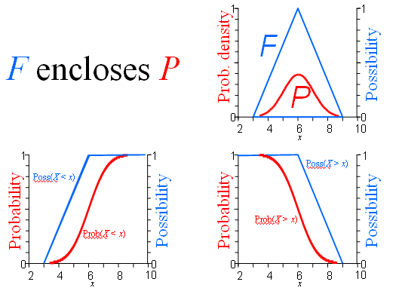
“Principles of Soft Computing, 2nd Edition”
by S.N. Sivanandam & SN Deepa
Copyright © 2011 Wiley India Pvt. Ltd. All rights reserved.

Slide 25
ADVANTAGES OF FUZZY ARITHMETIC
Requires little data.
Applicable to all kinds of uncertainty.
Fully comprehensive.
Fast and easy to compute.
Doesn’t require information about correlations.
Conservative, but not hyper-conservative
In between worst case and probability.
Backcalculations easy to solve.
“Principles of Soft Computing, 2nd Edition”
by S.N. Sivanandam & SN Deepa
Copyright © 2011 Wiley India Pvt. Ltd. All rights reserved.

Slide 26
LIMITATIONS OF FUZZY ARITHMETIC
Controversial.
Are alpha levels comparable for different variables?
Not optimal when there're a lot of data.
Can’t use knowledge of correlations to tighten answers.
Not conservative against all possible dependencies.
Repeated variables make calculations cumbersome.
“Principles of Soft Computing, 2nd Edition”
by S.N. Sivanandam & SN Deepa
Copyright © 2011 Wiley India Pvt. Ltd. All rights reserved.

Slide 27
SOFTWARES FOR FUZZY ARITHMETIC
FuziCalc
  (Windows 3.1) FuziWare, 800-472-6183
Fuzzy Arithmetic C++ Library
  (C code) anonymous ftp to mathct.dipmat.unict.it and get \fuzzy\fznum*.*
Cosmet (Phaser)
  (DOS, soon for Windows) acooper@sandia.gov
Risk Calc
  (Windows) 800-735-4350; www.ramas.com
“Principles of Soft Computing, 2nd Edition”
by S.N. Sivanandam & SN Deepa
Copyright © 2011 Wiley India Pvt. Ltd. All rights reserved.

Slide 28
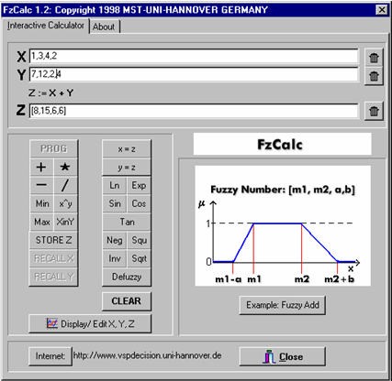
SCREEN SHOT OF FUZZY CALCULATOR - FzCalc
“Principles of Soft Computing, 2nd Edition”
by S.N. Sivanandam & SN Deepa
Copyright © 2011 Wiley India Pvt. Ltd. All rights reserved.

Slide 29
SUMMARY
This chapter has given an overview on Fuzzy Arithmetic and Fuzzy Measures.
“Principles of Soft Computing, 2nd Edition”
by S.N. Sivanandam & SN Deepa
Copyright © 2011 Wiley India Pvt. Ltd. All rights reserved.

